Slide 1
EDND 2024 Annual Meeting
Notes:
Brad:
Welcome, everyone.
I will now call EDND Annual Meeting to order

Slide 2
Agenda
Call to Order
2023 Annual Meeting Minutes Approval
Board Recognition
Financial Report
2024 Work Plan Review
Legislative Review
Outgoing Board Member Recognition
Other Business
Adjourn
Notes:
Approve agenda on next slide.

Slide 3
2023 Annual Meeting Minutes
Review
Approval
Notes:
Are there any additions or corrections?
Is there a motion to approve?
Is there a second?
All in favor say aye, All opposed say no
Motion carries.

Slide 4
2023-25 Board of Directors
President Brad Barth – Forward Devils Lake
Vice President Melissa Beach - Minnkota
Secretary/Treasurer Nathan Schneider – Bismarck Mandan Chamber EDC
Past President Teran Doerr – Bowman County Economic Development
At Large Corry Shevlin - Jamestown/Stutsman Development Corp
Brekka Kramer – Minot Area Chamber EDC
Ryan Jilek – Stark Development Corporation
Associate Member Justin Dever – MDU
Justin Pearson - BNSF Railway Development
Staff Dana Hager – Clearwater Communications
Laura Lacher – Clearwater Communications
Michaela Kauk – Clearwater Communications
Notes:
I would like to recognize the EDND board of directors for their time and dedication to strengthening EDND and the state’s economy. (Introduce the board members who are here)

Slide 5
Financial Report INCOME
 |  | Jan-Aug 2024 | 2024 Budget | % of Budget
Income
 | 4000 - Membership Dues | $ 47,509 | $ 48,000 | 99%
 | 4100 - Conferences | $ 67,876 | $ 55,000 | 123%
 | 4600 - Other Income | $ 289 | $ 350 | 83%
Total Income |  | $ 115,675 | $ 103,550 | 112%
Notes:
Turn over to Nathan Schneider as Secretary/Treasurer

Slide 6
Financial Report- expenses
 | Expense |  |  | Jan – Aug 2024 |  | 2024 Budget | % of Budget
 |  | 5000 · Professional Fees |  | $43,809 |  | $66,214 | 66%
 |  | 5100 · Legislative Program |  | $0 |  | $250 | 0%
 |  | 5200 · Office Expenses |  | $2,314 |  | $3,720 | 62%
 |  | 5300 · Other Expenses |  | $599 |  | $3,100 | 19%
 |  | 5400 · Conference Expenses |  | $37,795 |  | $30,000 | 126%
 |  | 5500 · Training Expenses |  | $0 |  | $500 | 0%
 |  | 5600 · Training Scholarships |  | $0 |  | $1,000 | 0%
 |  | 5700 · Sponsorships |  | $0 |  | $500 | 0%
 |  | 5800 · Awards |  | $1,130 |  | $3,000 | 37%
 |  | 5900 · Special Projects |  | $0 |  | $1,000 | 0%
 | Total Expense |  |  | $85,649 |  | $109,284 | 78%
Net Income |  |  |  | $30,025 |  | -$5,734
Notes:
Nathan Schneider – Secretary/Treasure

Slide 7
2024 Cash flow
 |  | Jan – Aug 24
Net cash provided by Operating Activities |  | $30,025
Net cash increase for period |  | $30,025
Cash at beginning of period |  | $151,680
Cash at end of period |  | $181,705
Notes:
Nathan Schneider – Secretary/Treasure

Slide 8
2024 Work Plan Updates
Knowledge Sharing & Networking
2025 advocacy
Outreach
2024 Conferences
Think Tank Calls
Community Success Stories
Advocacy Workship
Legislative Agenda
Developer Day
Associate Member Connections
Keep It Local
Monitoring Interim Committees
Promote Regional Groups
Notes:
Dana Hager/Laura Lacher

Slide 9
2023-24 Interim legislative Session
EDND Monitoring
Ag & Natural Resources Committee
Next Meeting - September 23, 2024
Energy Development and Transmission Committee
STAND Report from BND
Taxation Committee
Tax Relief Advisory Committee
Joined Keep It Local Coalition
Notes:
2023-2024 Interim Committees & Studies
Ag & Natural Resources – Next meeting the committee will discuss and propose recommendations on the proposed bill drafts related to the foreign adversaries’ ownership of property and assets. (currently three bill drafts)
Energy Development and Transmission – STAND Report (Sustain Transform Authenticate North Dakota) – Interim study on ESG trends, laws and policies that impact businesses and industries in North Dakota. This study is available online. Planning is important because economic opportunities will increase demands on electricity, roadways and transportation in the state.
Taxation Committee – Sept. 5 hearing – heard from Tax Foundation and Tax Commissioner & Association of Counties about property tax elimination impacts. One bill is being recommended to Legislative Management, for consideration – “Growing of Agricultural Commodities” for purposes of property tax classifications. Find the Good Life and Renaissance Zone program updates were presented.
Renaissance Zones: 51 Renaissance Zones in ND. In 2023, 7 communities reached expiration date and all received a 5 or 10-year extension. In 2023, 55 projects were approved at the state and local level and 41 projects were completed.
Tax Relief Advisory Committee – Last met on Sept. 4 – Received economic impact of income and property tax reform from the Tax Foundation. No bill drafts were approved by the committee w/ little known until the election and Measure 4 is addressed.

Slide 10
2025 legislative Session
Advocacy & Lobbying for 69th Legislative Assembly
Member survey to prioritize EDND’s legislative agenda
Organizational Session – December 2-4, 2024
Session begins – January 7, 2025
Crossover date for bills – February 28, 2025
Legislative Social – March 17, 2025
Partnership with GNDC & AGC
80 Legislative Days – May 2, 2025

Slide 11
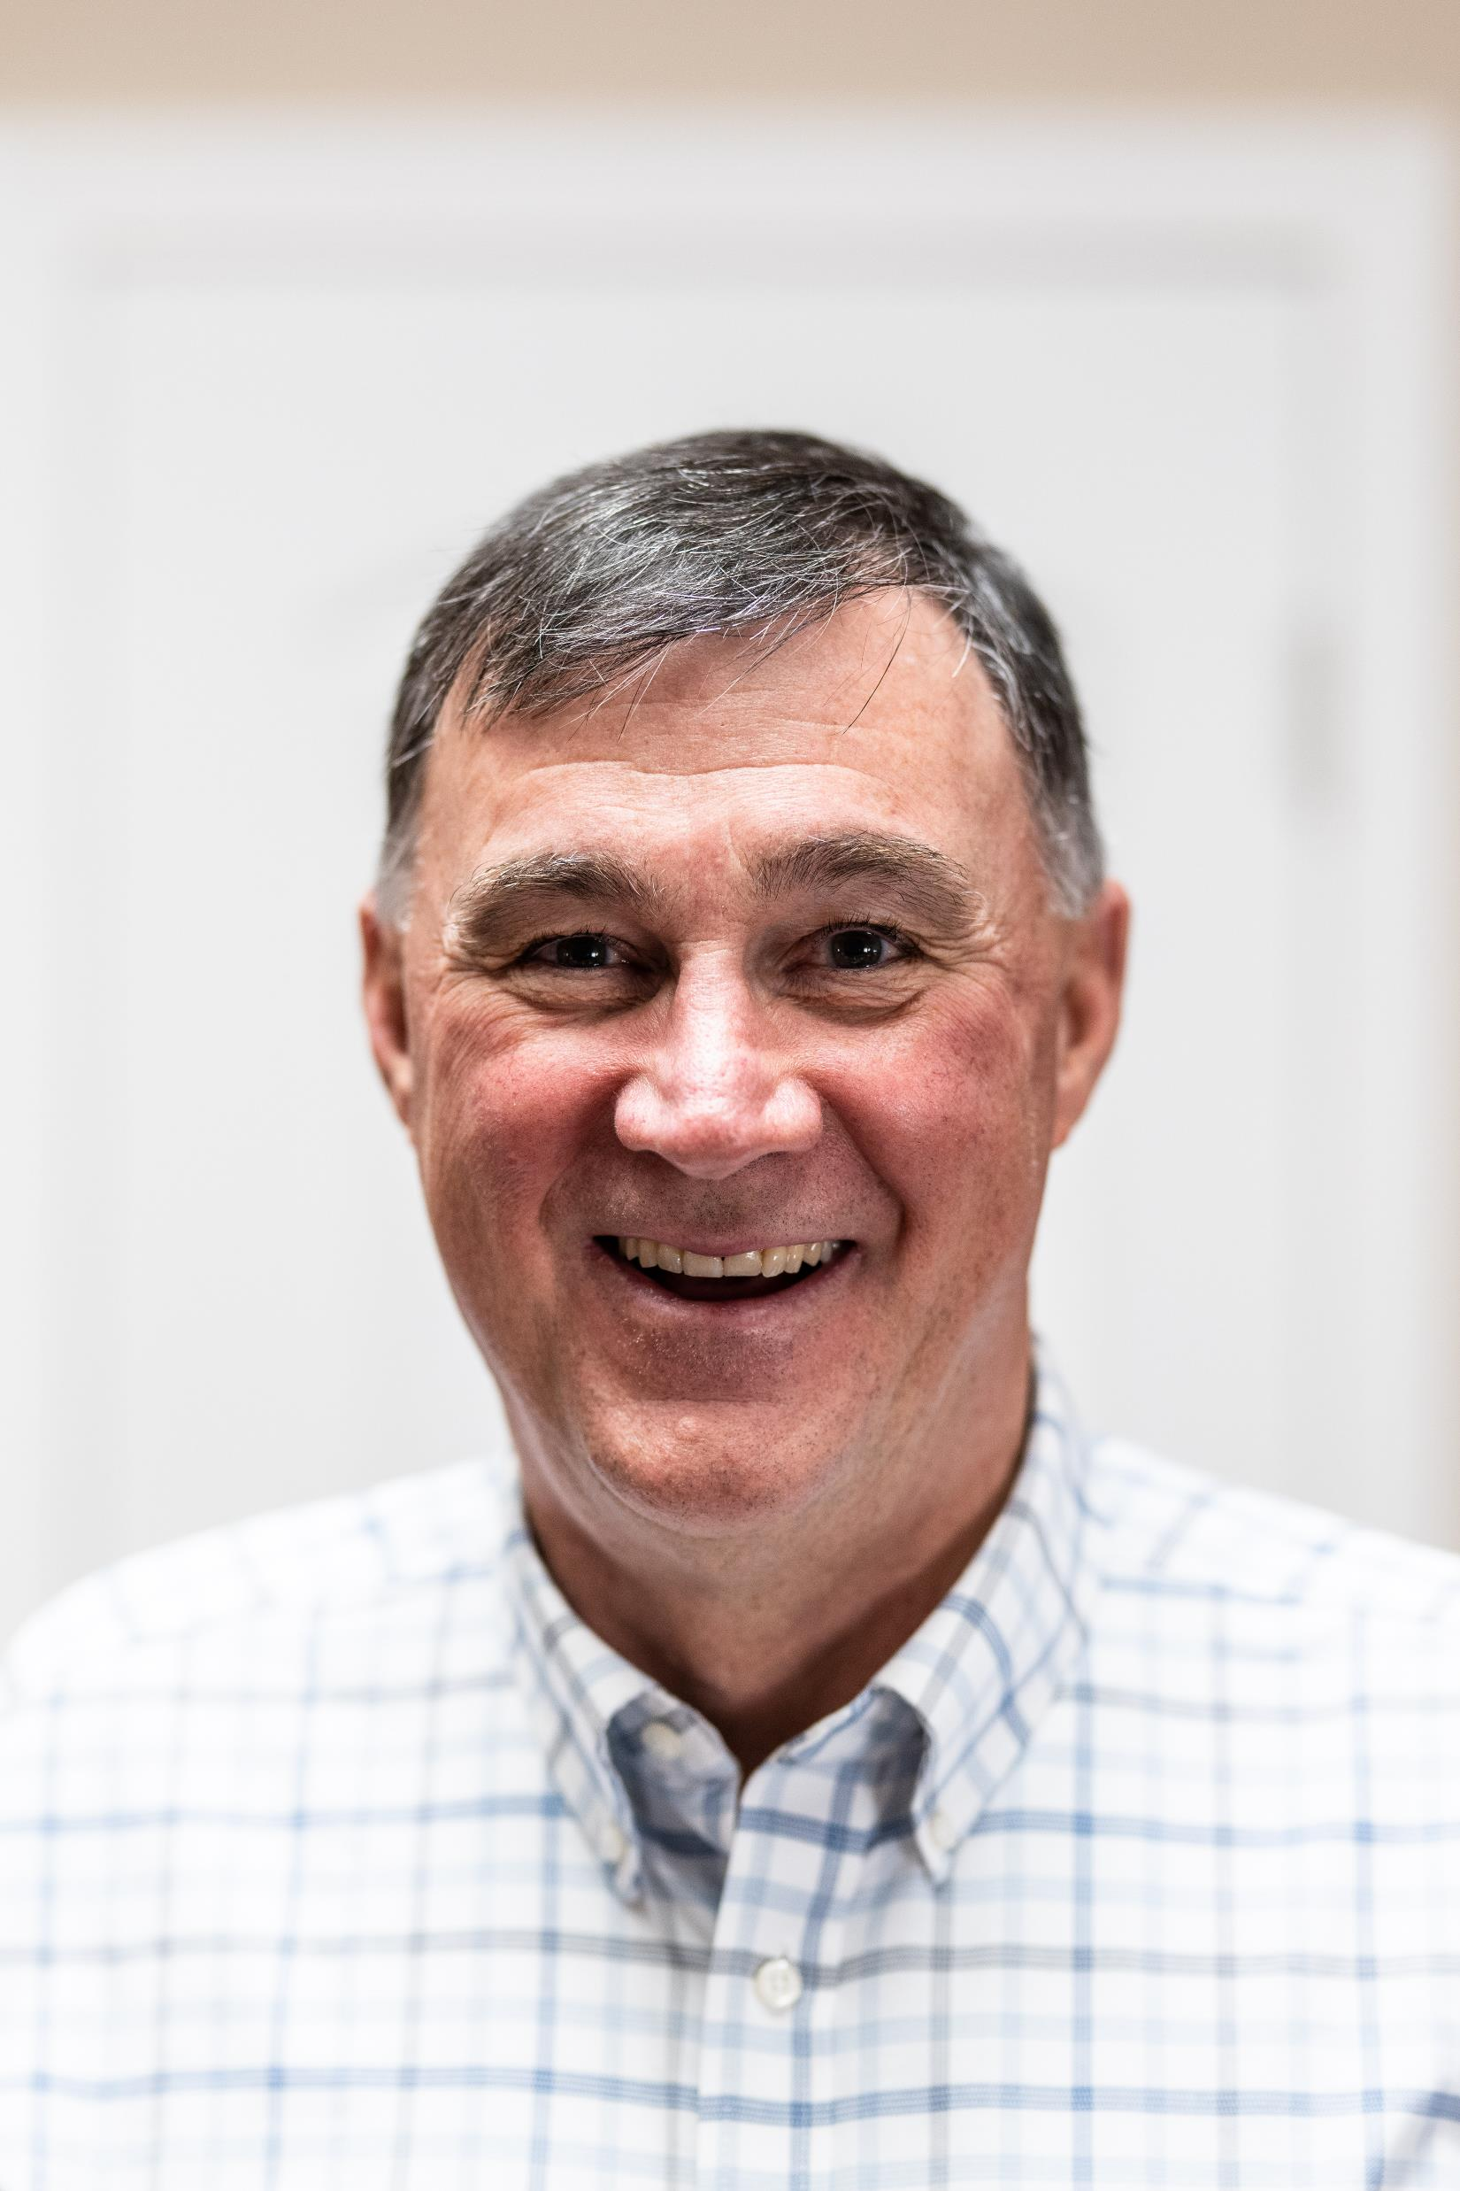
OutGOing President
Brad Barth
Forward Devils Lake
Notes:
Have Brad say a few words and Teran thank him and give him a gift.

Slide 12
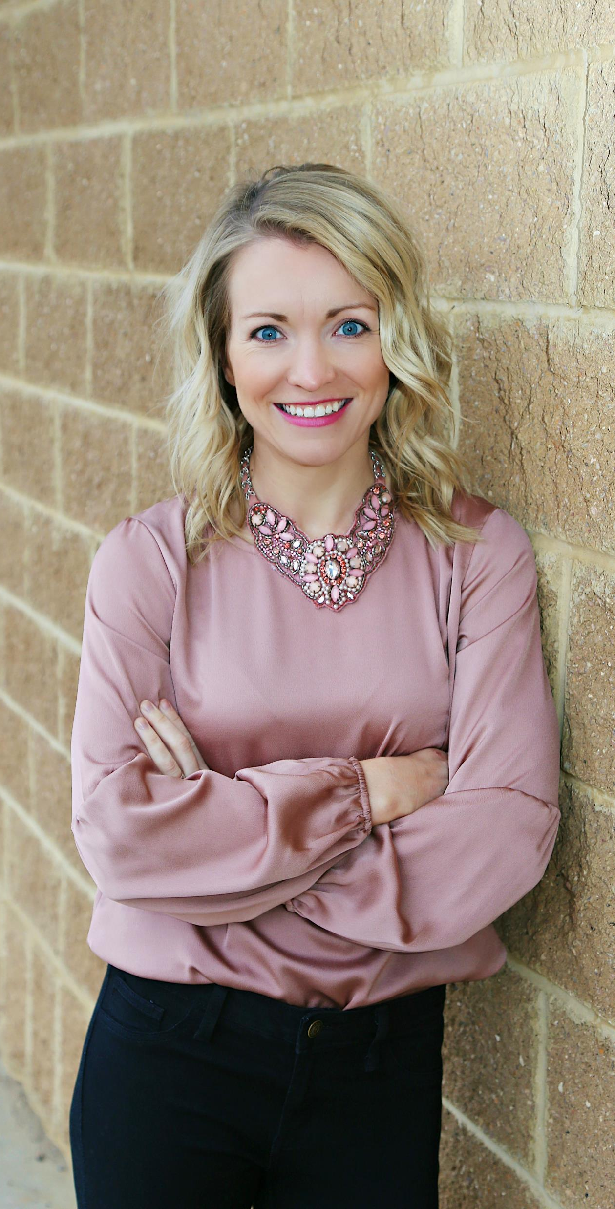
Incoming Interim President
Teran Doerr
Bowman County Development Cooperation
Notes:
Welcome Teran to the floor to finish he meeting.
No vote needed based on EDND bylaws

Slide 13
2024-2025 Board of Directors
President
Teran Doerr
Bowman County Development Corporation
Vice President
Melissa Beach
Minnkota Power Cooperative
Secretary/Treasurer
Nathan Schneider
Bismarck-Mandan Chamber EDC
Past President
N/A
Members-At-Large
Corry Shevlin
Jamestown Stutsman Development Corporation
Brekka Kramer
Minot Area Chamber EDC
Ryan Jilek
Stark Development Corporation
Associate Members
Justin Pearson
BNSF
Justin Dever
MDU

Slide 14
Next Steps
2025 Legislative Session
2025 Fall Conference
Notes:
Turn over to Laura
Gearing up for Legislative Session
RFP is out for the fall 2025 conference – no conference next spring due to Legislative Session.

Slide 15
Adjournment
We are looking forward to continued success in 2025!
Notes:
Turn back to Teran to adjourn the meeting.
Thanks, everyone. The meeting is now adjourned.

